Slide 1
Chapter 4
I/O Port Programming

Slide 2
Outlines
8051 pin functions
4 ports of 8051
Dual role of port 0 for data & address
Code assembly language to use ports
Use of port 3 for interrupt signals
Code 8051 instructions for I/O handling
Code bit-manipulation instructions

Slide 3
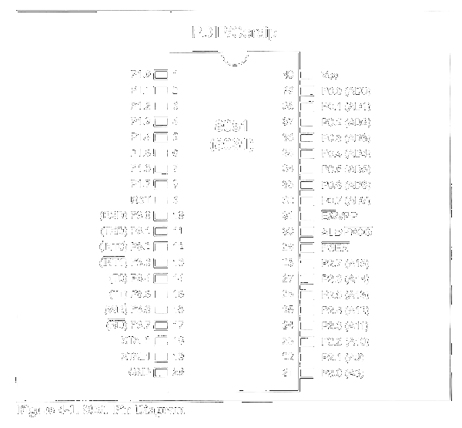
8051 Pin Diagram

Slide 4
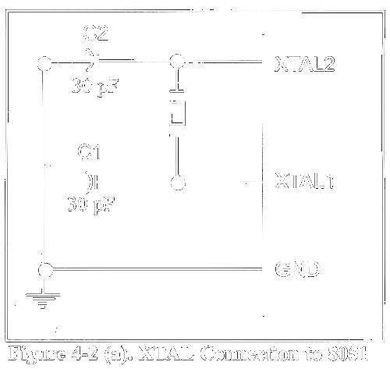
Clock Generation

Slide 5
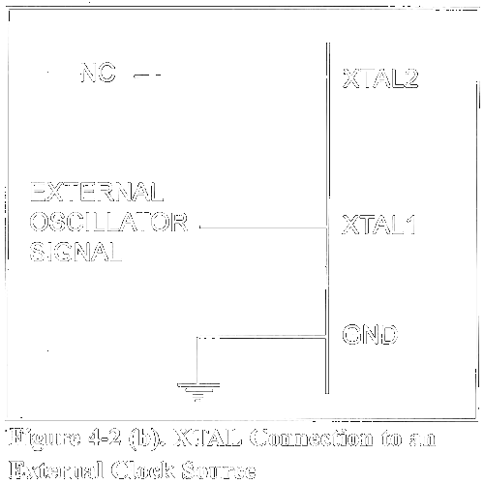
Clock Generation

Slide 6

Machine & Clock Cycles

Slide 7
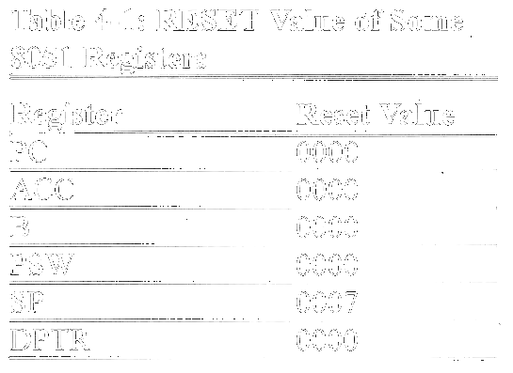
RESET Value of Registers

Slide 8
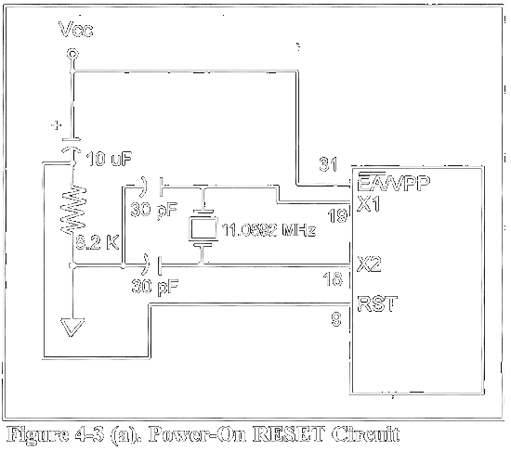
RESET Circuits

Slide 9
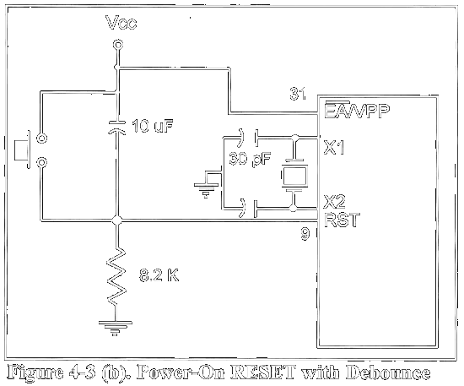
RESET Circuits

Slide 10
Pins for External ROM/RAM
EA (external access)
  V_{CC}: on-chip ROM
  GND: external ROM
PSEN (program store enable)
  to OE (output enable) pin of ROM
ALE (address latch enable)
  to G (enable) pin of 74LS373
See Chapter 14

Slide 11
Port 0: I/O, Open Drain
Initially configured as output
MOV A,#55H
BACK: MOV P0,A
ACALL DELAY
CPL A
SJMP BACK

Slide 12
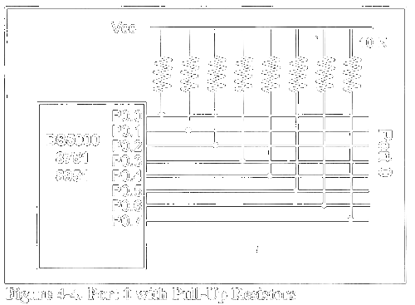
Port 0: I/O, Open Drain

Slide 13
Port 0 as Input: Write all 1s
MOV A,#0FFH ;A = FF hex
MOV P0,A ;make P0 an input port
;by writing all 1s to it
BACK: MOV A,P0 ;get data from P0
MOV P1,A ;send it to port 1
SJMP BACK ;keep doing it
Dual role of port 0
  Can be configured as AD0 – AD7

Slide 14
Port 1: I/O, No Pull-up Resistors
Initially configured as output
MOV A,#55H
BACK: MOV P1,A
ACALL DELAY
CPL A
SJMP BACK
MOV A,#0FFH ;A=FF hex
MOV P1,A ;make P1 an input port
;by writing all 1s to it
MOV A,P1 ;get data from P1
MOV R7,A ;save it in reg R7
ACALL DELAY ;wait
MOV A,P1 ;get another data from P1
MOV R6,A ;save it in reg R6
ACALL DELAY ;wait
MOV A,P1 ;get another data from P1
MOV R5,A ;save it in reg R5

Slide 15
Port 2: I/O, No Pull-up Resistors
Initially configured as output
MOV A,#55H
BACK: MOV P2,A
ACALL DELAY
CPL A
SJMP BACK
MOV A,#0FFH ;A=FF hex
MOV P2,A ;make P2 an input port by
;writing all 1s to it
BACK: MOV A,P2 ;get data from P2
MOV P1,A ;send it to Port 1
SJMP BACK ;keep doing that
Dual role of port 2: A8-A15

Slide 16
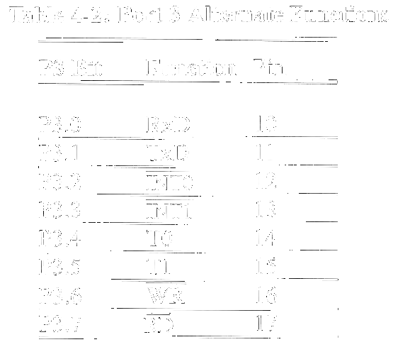
Port 3: I/O, No Pull-up Resistors

Slide 17
Different Ways of Accessing 8 bits
BACK: MOV A,#55H
MOV P1,A
ACALL DELAY
MOV A,#0AAH
MOV P1,A
ACALL DELAY
SJMP BACK
MOV P1,#55H ;P1=01010101
AGAIN: XLR P1,#0FFH ;EX-OR ;P1 with 1111 1111
ACALL DELAY
SJMP AGAIN
BACK: MOV P1,#55H
ACALL DELAY
MOV P1,#0AAH
ACALL DELAY
SJMP BACK

Slide 18
Single-bit Addressability of Ports
BACK: CPL P1.2 ;complement P1.2 only
ACALL DELAY
SJMP BACK
;another variation of the above program follows
AGAIN: SETB P1.2 ;change only P1.2=high
ACALL DELAY
CLR P1.2 ;change only P1.2=low
ACALL DELAY
SJMP AGAIN

Slide 19
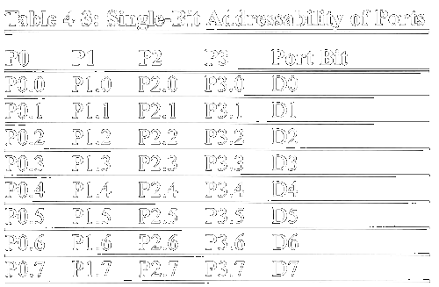
Single-bit Addressability of Ports

Slide 20

Example 4-2

